Slide 1
Queues

Slide 2
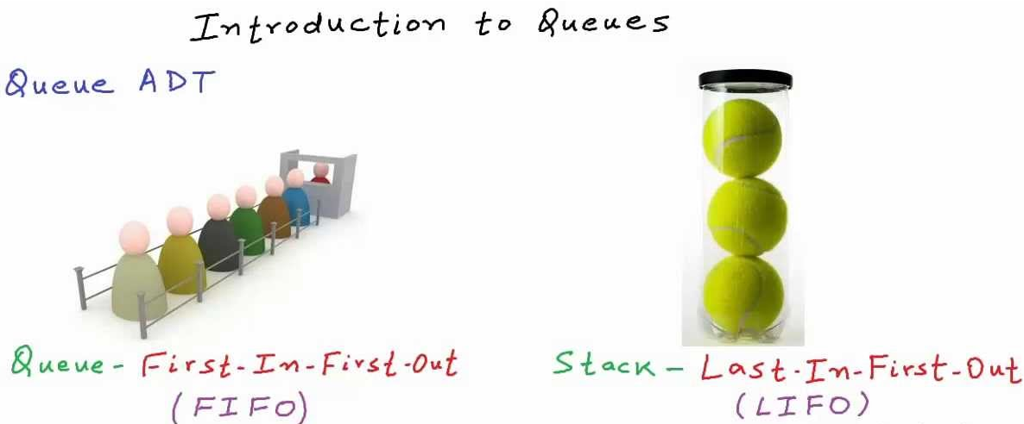

Slide 3

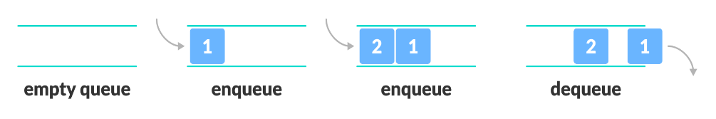
QUEUE: -Ordered List. -Insertion at one end called REAR. -Deletion at another end called FRONT. -FIFO (First In First Out)
Operations:
Enqueue: Add an item to the queue.
Dequeue: Remove an item from the queue.
Peek: Gets the element at the front of the queue without removing it.
IsFull :Checks if the queue is full.
IsEmpty: Checks if the queue is empty.

Slide 4
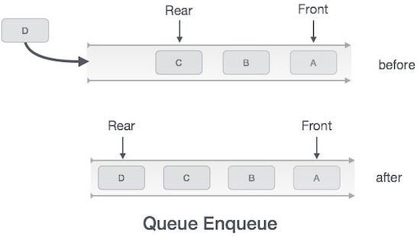
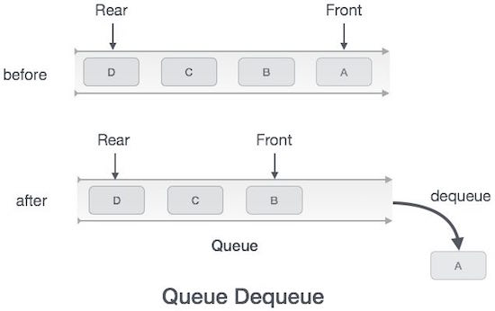
QUEUE:

Slide 5
ARRAY BASED IMPLEMENTATION OF QUEUE Declaration: int queue[max],front=-1,rear=-1;
ENQUEUE OPERATION:
void enqueue(int x)
{
if(rear==max-1)
cout<<"Queue is full";
else
{
rear++;
queue[rear]=x;
if(front==-1)
front=0;
}
}

Slide 6
DEQUEUE OPERATION: int dequeue() { int item; if(front==-1) { cout<<"Queue is empty "; } else { item=queue[front]; if(front==rear) { front=-1; rear=-1; } else front++; } return item; }

Slide 7
LINKED LIST IMPLEMETATION OF QUEUE struct queue { int data; struct queue* next; }*FRONT=NULL,*REAR=NULL,*pos=NULL;

Slide 8
LINKED LIST IMPLEMETATION OF QUEUE: ENQUEUE: void Enqueue() { int value; struct queue* newnode; newnode=new queue(); cout<<"Enter Data:”; cin>>value; newnode->data=value; newnode->next=NULL; if(FRONT==NULL && REAR==NULL) { FRONT=newnode; REAR=newnode; }else { REAR->next=newnode; REAR=newnode; }}

Slide 9
LINKED LIST IMPLEMETATION OF QUEUE: DEQUEUE: void Dequeue() { struct queue* delnode; if(FRONT==NULL && REAR==NULL) { cout<<"QUEUE IS EMPTY"; return; } else { delnode=FRONT; FRONT=delnode->next; delete delnode; } }

Slide 10
APPLICATIONS OF QUEUE: 1) When a resource is shared among multiple consumers. Examples include CPU scheduling, Disk Scheduling. 2) When data is transferred asynchronously (data not necessarily received at same rate as sent) between two processes. Examples include IO Buffers, pipes, file IO, etc. 3)Jobs sent to Line Printer are placed on a queue. 4)Breadth First Search

Slide 11
DIFFERENT TYPES OF QUEUES
Queue can be of four types:
1. Simple Queue
2. Circular Queue
3. Priority Queue
4. Dequeue (Double Ended queue)

Slide 12
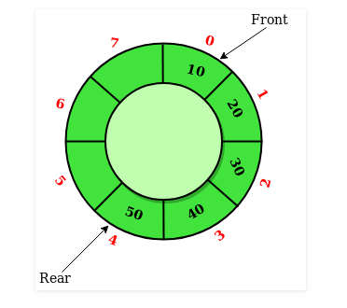
CIRCULAR QUEUE -Circular Queue is a linear data structure in which the operations are performed based on FIFO (First In First Out) principle and the last position is connected back to the first position to make a circle. It is also called ‘Ring Buffer’.

Slide 13
BENEFITS OF CIRCULAR QUEUE: In a linear queue after the queue is full, we delete the elements from another end, and the status of the queue is still shown as full and we cannot insert more elements. In the circular queue, when the queue is full, and when we remove elements from the front since last and first positions are connected, we can insert the elements at the rear which was vacated by deleting the element.

Slide 14
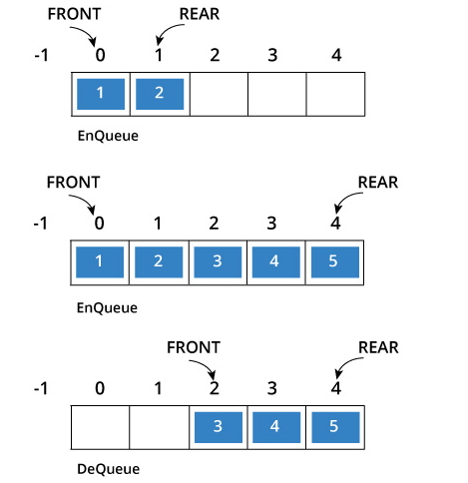
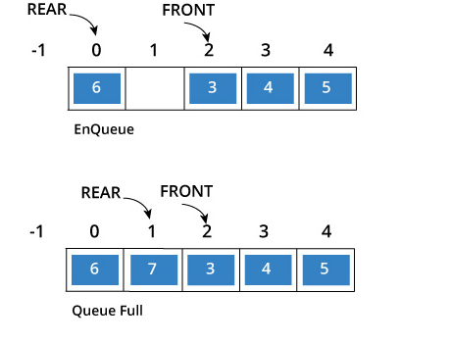

Slide 15
ENQUEUE: void enqueue(int x) { if(front==(rear+1)%MAX) cout<<"Queue is full..."; else { rear=(rear+1)%MAX; queue[rear]=x; if(front==-1) front=0; } }

Slide 16
DEQUEUE: int dequeue() { int item; if(front==-1) cout<<"The Queue is empty..."; else { item=queue[front]; if(front==rear) { front=-1; rear=-1; } else front=(front+1)%MAX; } return item; }

Slide 17
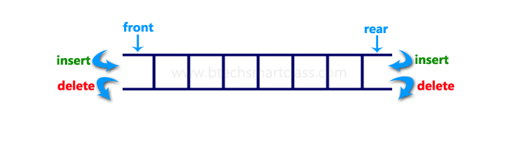
DEQUEUE: DOUBLE ENDED QUEUE -Double Ended Queue is also a Queue data structure in which the insertion and deletion operations are performed at both the ends. -Insertion at both front and rear positions and deletion from both front and rear positions.

Slide 18
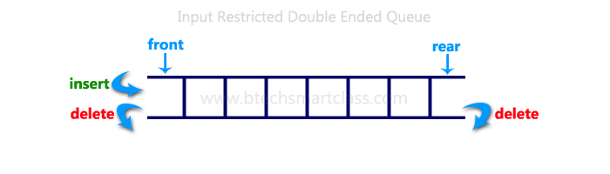
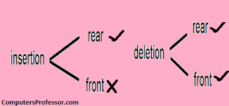
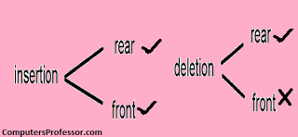
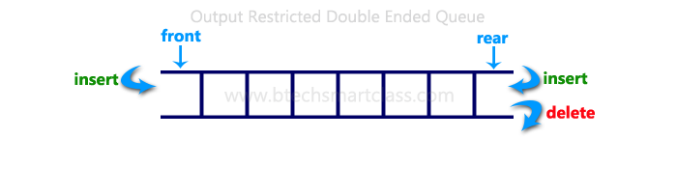
Double Ended Queue can be represented in TWO ways: 1.Input Restricted Double Ended Queue: -The insertion operation is performed at only one end and deletion operation is performed at both the ends. 2.Output Restricted Double Ended Queue: - In output restricted double ended queue, the deletion operation is performed at only one end and insertion operation is performed at both the ends.

Slide 19
INSERTION USING REAR void insert_rear(int x) { if(rear==max-1) cout<<"Queue is full"; else { rear=rear+1; queue[rear]=x; if(front==-1) front=0; } }

Slide 20
INSERTION USING FRONT void insert_front(int x) { if(front==0) cout<<"Cannot insert in front position "; else { if(front==-1) { front=front+1; queue[front]=x; if(rear==-1) rear=0; } else { front=front-1; queue[front]=x; } } }

Slide 21
DELETION USING REAR int delete_rear() { int item; if(rear==-1) { cout<<"Queue is empty "; } else { item=queue[rear]; if(front==rear) { front=-1; rear=-1; } else { rear=rear-1; }} return item;}

Slide 22
DELETION USING FRONT int delete_front() { int item; if(front==-1) printf("Queue is full"); else { item=queue[front]; if(front==rear) { rear=-1; front=-1; } else { front=front+1; } } return item; }

Slide 23
Priority Queues: -Priority Queue is an extension of queue with following properties. -Every item has a priority associated with it. -An element with high priority is dequeued before an element with low priority. -If two elements have the same priority, they are served according to their order in the queue. Operations: insert(item, priority): Inserts an item with given priority. getHighestPriority(): Returns the highest priority item. deleteHighestPriority(): Removes the highest priority item.

Slide 24
Priority queue is a variant of queue data structure in which insertion is performed in the order of arrival and deletion is performed based on the priority.
There are two types of priority queues they are as follows...
Max Priority Queue
Min Priority Queue

Slide 25
1. Max Priority Queue
In max priority queue, elements are inserted in the order in which they arrive the queue and always maximum value is removed first from the queue.
For example assume that we insert in order 8, 3, 2, 5 and they are removed in the order 8, 5, 3, 2.

Slide 26
2. Min Priority Queue
Min Priority Queue is similar to max priority queue except removing maximum element first, we remove minimum element first in min priority queue.

Slide 27
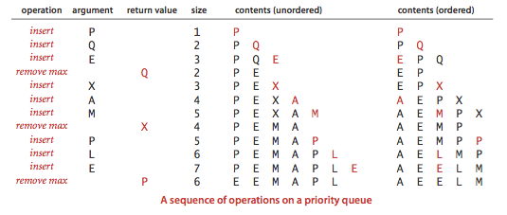

Slide 28
Applications of Priority Queue: 1) CPU Scheduling 2) Graph algorithms like Dijkstra’s shortest path algorithm, Prim’s Minimum Spanning Tree, etc 3) All queue applications where priority is involved. Implementations: -Array -Linked list -Heap data structure -Binary search tree Among these data structures, heap data structure provides an efficient implementation of priority queues.

Slide 29
LINKED LIST IMPLEMENTATION OF PRIORITY QUEUE struct node { int data; int priority; struct node*next; }*front=NULL;

Slide 30
void insert(int x,int p) { node*temp,*q; temp=new node; temp->data=x; temp->priority=p; if(front==NULL||p<front->priority) { temp->next=front; front=temp; } else { q=front; while(q->next!=NULL&&q->next->priority<p) { q=q->next; } temp->next=q->next; q->next=temp; } }

Slide 31
void dequeue() { struct node*delnode; if(front==NULL) cout<<"Queue underflow"; else { delnode=front; cout<<front->data; front=front->next; free(delnode); } }

Slide 32
void display() { node*pos; pos=front; if(front==NULL) cout<<"queue is empty"; else { while(pos!=NULL) { cout<<pos->data<<" "<<pos->priority<<endl; pos=pos->next; } } }

